Slide 1

Variable selection in a joint model for Huntington’s disease data
Rajan Shankar, Tanya Garcia, Garth Tarr
School of Mathematics and Statistics
Faculty of Science

Slide 2
Overview
Variable selection
Revival analysis

Slide 3
Overview
Variable selection
Revival analysis
Outcome
Censored time-to-event variable

Slide 4
Overview
Variable selection
Revival analysis
Outcome
Censored time-to-event variable
Predictor variables

Slide 5
Overview
Variable selection
Revival analysis
Outcome
Censored time-to-event variable
Predictor variables

Slide 6

Overview
Variable selection
Revival analysis
Outcome
Selection
Censored time-to-event variable
Selection
Predictor variables

Slide 7
Overview
Variable selection
Revival analysis
Motivated by Huntington’s disease studies
Outcome
Selection
Censored time-to-event variable
Selection
Predictor variables

Slide 8

Huntington’s disease
Neurodegenerative disease
Inherited
Caused by a mutation in the Huntingtin (HTT) gene
Notes:
Like Alzheimer’s
Unlike Alzheimer’s is completely due to genetics
Rare disease, <0.01% (<1 in 10,000)
We all have the HTT gene, the problem is when it is mutated
Interesting disease from a modelling perspective because depending on the severity of the mutation, we know at birth who’s guaranteed to develop it

Slide 9
Diagnosis
Clinical diagnosis occurs once motor skills deteriorate
Cognitive decline starts much earlier
Notes:
Emphasise what it means for someone to be ‘diagnosed’ with the disease
Even if they are guaranteed to develop it, they aren’t ‘diagnosed’ with it until motor skills have declined enough
Clinicians are interested in how cognitive health declines prior to the disease to enable timely interventions

Slide 10
Diagnosis
Clinical diagnosis occurs once motor skills deteriorate
Cognitive decline starts much earlier
Age:
0
30
40
45
Birth
Cognitive decline
Motor decline
Diagnosis
Notes:
Emphasise what it means for someone to be ‘diagnosed’ with the disease
Even if they are guaranteed to develop it, they aren’t ‘diagnosed’ with it until motor skills have declined enough
Clinicians are interested in how cognitive health declines prior to the disease to enable timely interventions

Slide 11
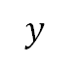
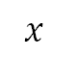
Interest
Cognitive health ($y$) vs time-to-diagnosis ($x$)
$$y$$
100
0
$$x$$
1
5
9
13
Notes:
Therefore, we are interested in modelling cognitive health as individuals get closer to developing the disease (TTD)
Assume this linear relationship
How do we know how long they have left?

Slide 12
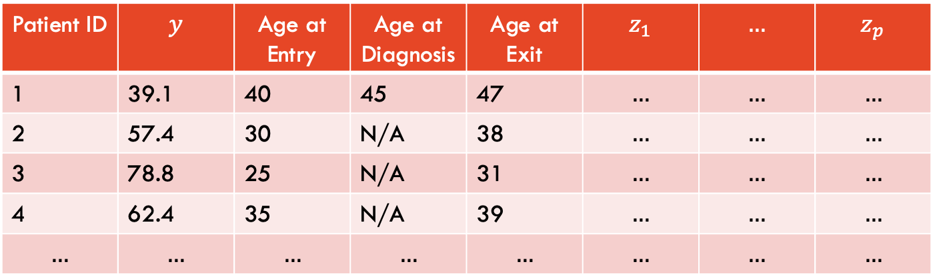
Data set
Additional predictors
Patient ID | $$y$$ | Age at Entry | Age at Diagnosis | Age at Exit | $$z_{1}$$ | $$…$$ | $$z_{p}$$
1 | 39.1 | 40 | 45 | 47 | $$…$$ | $$…$$ | $$…$$
2 | 57.4 | 30 | N/A | 38 | $$…$$ | $$…$$ | $$…$$
3 | 78.8 | 25 | N/A | 31 | $$…$$ | $$…$$ | $$…$$
4 | 62.4 | 35 | N/A | 39 | $$…$$ | $$…$$ | $$…$$
$$…$$ | $$…$$ | $$…$$ | $$…$$ | $$…$$ | $$…$$ | $$…$$ | $$…$$
Notes:
First see what the data looks like
Decade-long clinical study with many patients
Go through columns (all non-age variables are at baseline, i.e. at study entry)
Yearly check-ups to determine if they have the disease yet
Explain how x can be calculated for some patients
For others, it is censored (no Age at Diagnosis, so best we can do is use Age at Exit)

Slide 13
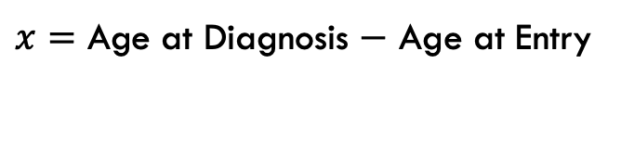
Data set
$x=$ Age at Diagnosis $−$ Age at Entry
Patient ID | $$y$$ | Age at Entry | Age at Diagnosis | Age at Exit | $$z_{1}$$ | $$…$$ | $$z_{p}$$
1 | 39.1 | 40 | 45 | 47 | $$…$$ | $$…$$ | $$…$$
2 | 57.4 | 30 | N/A | 38 | $$…$$ | $$…$$ | $$…$$
3 | 78.8 | 25 | N/A | 31 | $$…$$ | $$…$$ | $$…$$
4 | 62.4 | 35 | N/A | 39 | $$…$$ | $$…$$ | $$…$$
$$…$$ | $$…$$ | $$…$$ | $$…$$ | $$…$$ | $$…$$ | $$…$$ | $$…$$
Notes:
First see what the data looks like
Decade-long clinical study with many patients
Go through columns (all non-age variables are at baseline, i.e. at study entry)
Yearly check-ups to determine if they have the disease yet
Explain how x can be calculated for some patients
For others, it is censored (no Age at Diagnosis, so best we can do is use Age at Exit)

Slide 14
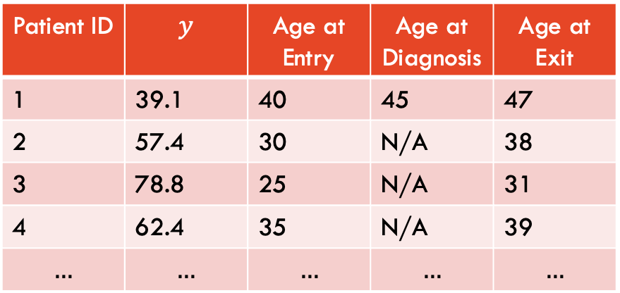
Data set
$x=$ Age at Diagnosis $−$ Age at Entry
Patient ID | $$y$$ | Age at Entry | Age at Diagnosis | Age at Exit
1 | 39.1 | 40 | 45 | 47
2 | 57.4 | 30 | N/A | 38
3 | 78.8 | 25 | N/A | 31
4 | 62.4 | 35 | N/A | 39
$$…$$ | $$…$$ | $$…$$ | $$…$$ | $$…$$
Notes:
First see what the data looks like
Decade-long clinical study with many patients
Go through columns (all non-age variables are at baseline, i.e. at study entry)
Yearly check-ups to determine if they have the disease yet
Explain how x can be calculated for some patients
For others, it is censored (no Age at Diagnosis, so best we can do is use Age at Exit)

Slide 15
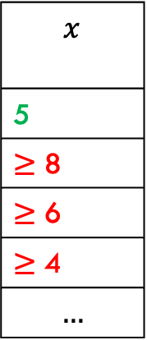
Data set
$x=$ Age at Diagnosis $−$ Age at Entry
Patient ID | $$y$$ | Age at Entry | Age at Diagnosis | Age at Exit
1 | 39.1 | 40 | 45 | 47
2 | 57.4 | 30 | N/A | 38
3 | 78.8 | 25 | N/A | 31
4 | 62.4 | 35 | N/A | 39
$$…$$ | $$…$$ | $$…$$ | $$…$$ | $$…$$
$$x$$
5
$≥$ 8
$≥$ 6
$≥$ 4
$$…$$
Notes:
First see what the data looks like
Decade-long clinical study with many patients
Go through columns (all non-age variables are at baseline, i.e. at study entry)
Yearly check-ups to determine if they have the disease yet
Explain how x can be calculated for some patients
For others, it is censored (no Age at Diagnosis, so best we can do is use Age at Exit)

Slide 16
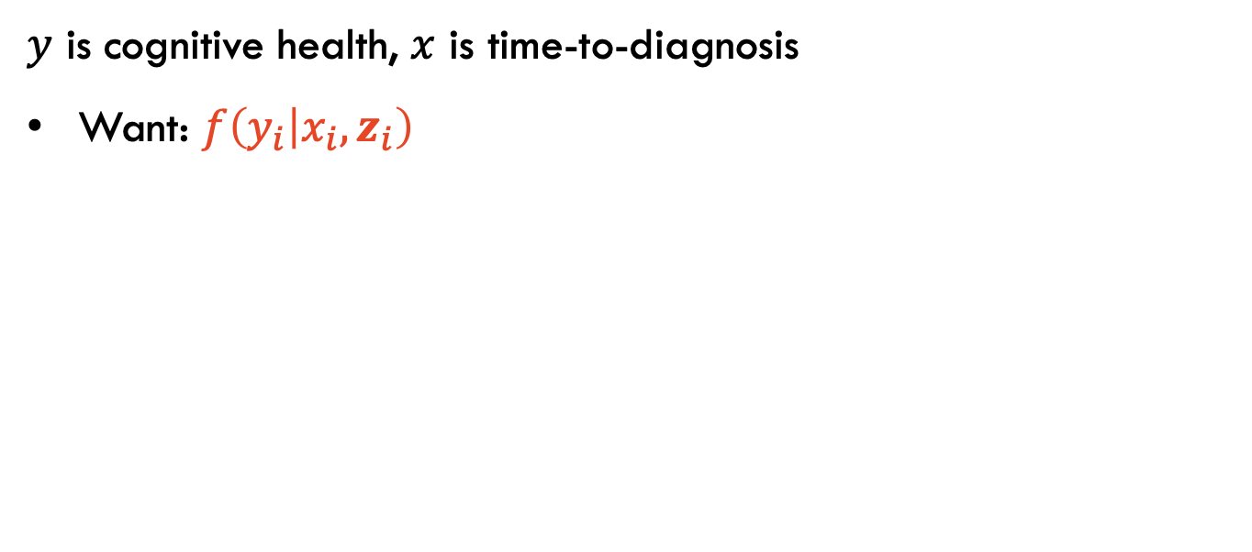
Modelling
$y$ is cognitive health, $x$ is time-to-diagnosis
Want: $f\left(y_{i} | x_{i},z_{i}\right)$
Notes:
Remember, we are interested in modelling y as a function of x (and other predictors z)
x is not available for all observations, so need some way of imputing x for when it is censored
Instead of this two-step approach of imputing and then modelling, we take advantage of the bidirectional relationship between y and x
Explain how high y means high TTD and vice versa
Decompose joint density into a product of two densities

Slide 17
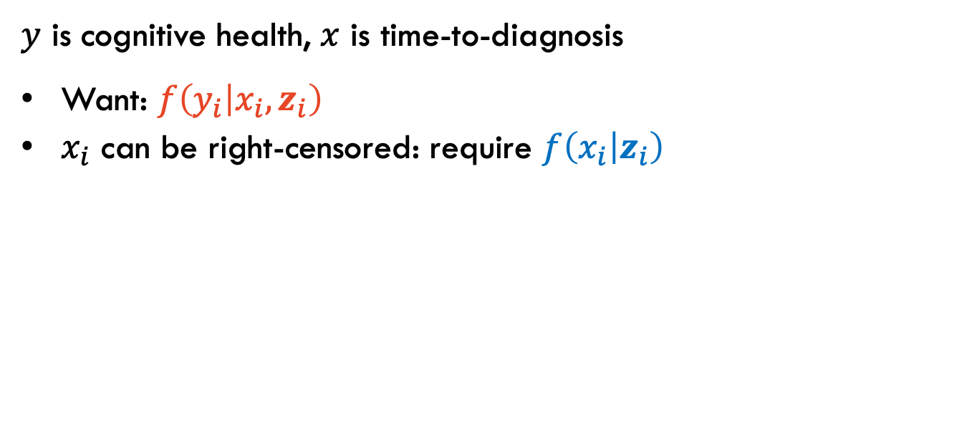
Modelling
$y$ is cognitive health, $x$ is time-to-diagnosis
Want: $f\left(y_{i} | x_{i},z_{i}\right)$
$x_{i}$ can be right-censored: require $f\left(x_{i} | z_{i}\right)$
Notes:
Remember, we are interested in modelling y as a function of x (and other predictors z)
x is not available for all observations, so need some way of imputing x for when it is censored
Instead of this two-step approach of imputing and then modelling, we take advantage of the bidirectional relationship between y and x
Explain how high y means high TTD and vice versa
Decompose joint density into a product of two densities

Slide 18
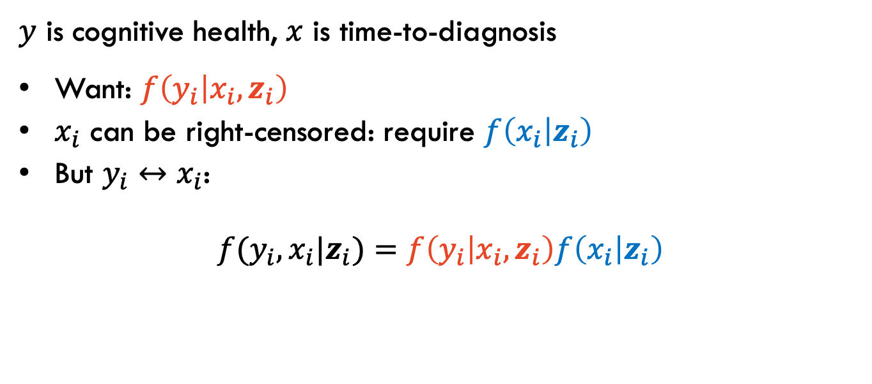
Modelling
$y$ is cognitive health, $x$ is time-to-diagnosis
Want: $f\left(y_{i} | x_{i},z_{i}\right)$
$x_{i}$ can be right-censored: require $f\left(x_{i} | z_{i}\right)$
But $y_{i}↔x_{i}$:
$$f(y_{i},x_{i}|z_{i})=f\left(y_{i} | x_{i},z_{i}\right)f\left(x_{i} | z_{i}\right)$$
Notes:
Remember, we are interested in modelling y as a function of x (and other predictors z)
x is not available for all observations, so need some way of imputing x for when it is censored
Instead of this two-step approach of imputing and then modelling, we take advantage of the bidirectional relationship between y and x
Explain how high y means high TTD and vice versa
Decompose joint density into a product of two densities

Slide 19
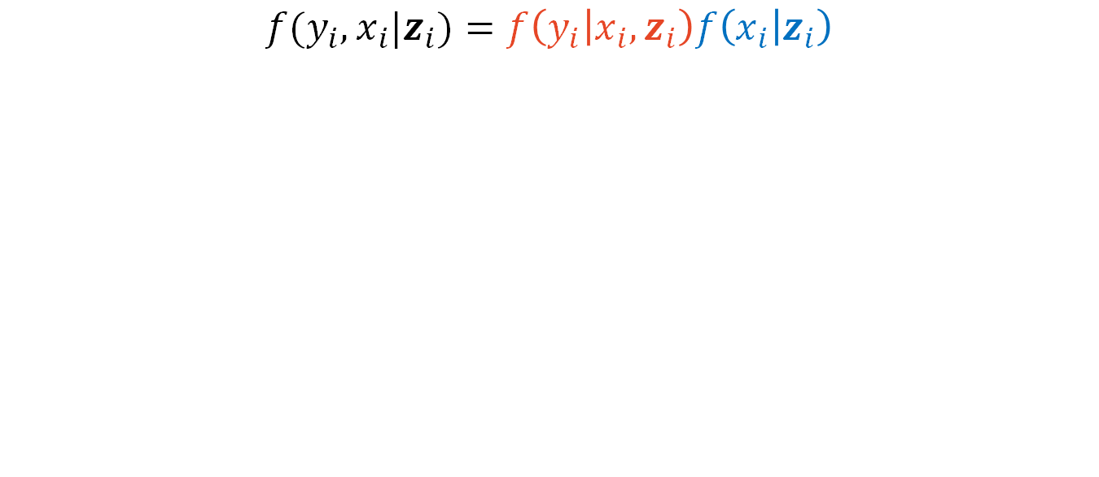
Modelling
$$f(y_{i},x_{i}|z_{i})=f\left(y_{i} | x_{i},z_{i}\right)f\left(x_{i} | z_{i}\right)$$
Notes:
Emphasise the linear predictor for the mean of the normal distribution (as shown in previous plot, y vs x relationship is linear)
Exponential distribution is parametrised by mean which is > 0, so exponentiate to guarantee positivity
beta and gamma contain 0’s which represent the intercept
The coefficients don’t have to be the same

Slide 20
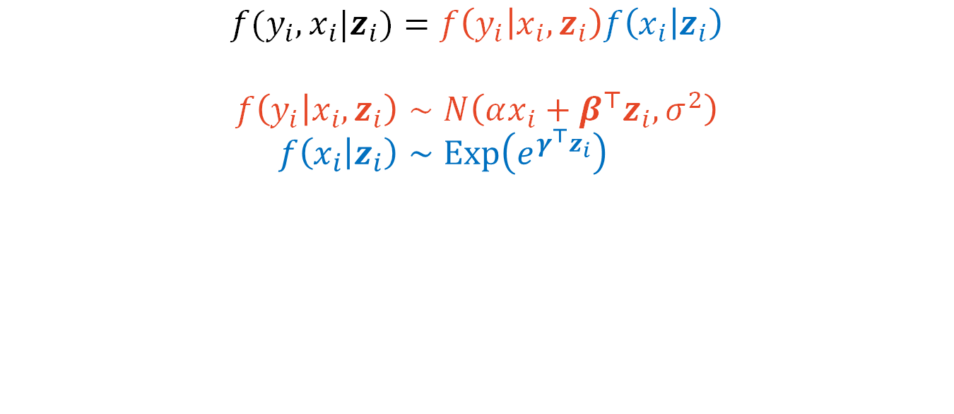
Modelling
$$f(y_{i},x_{i}|z_{i})=f\left(y_{i} | x_{i},z_{i}\right)f\left(x_{i} | z_{i}\right)$$
$$f\left(y_{i} | x_{i},z_{i}\right)∼N\left(αx_{i}+β^{⊤}z_{i},σ^{2}\right) \\ f\left(x_{i} | z_{i}\right)∼Exp\left(e^{γ^{⊤}z_{i}}\right)$$
Notes:
Emphasise the linear predictor for the mean of the normal distribution (as shown in previous plot, y vs x relationship is linear)
Exponential distribution is parametrised by mean which is > 0, so exponentiate to guarantee positivity
beta and gamma contain 0’s which represent the intercept
The coefficients don’t have to be the same

Slide 21
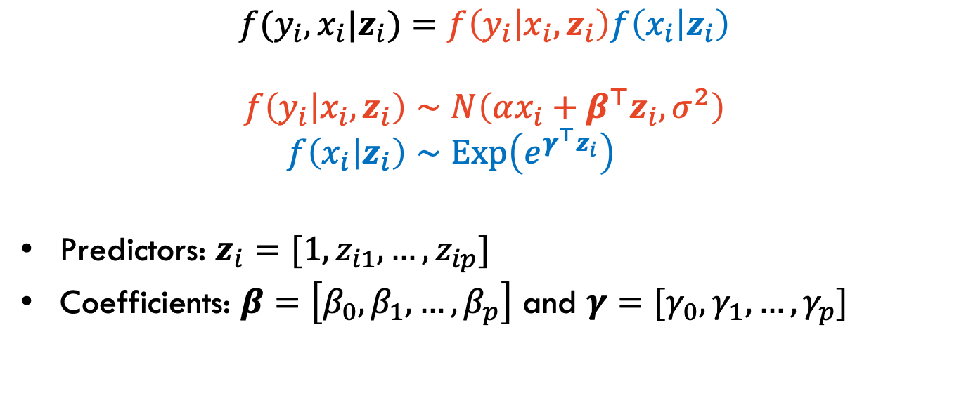
Modelling
$$f(y_{i},x_{i}|z_{i})=f\left(y_{i} | x_{i},z_{i}\right)f\left(x_{i} | z_{i}\right)$$
$$f\left(y_{i} | x_{i},z_{i}\right)∼N\left(αx_{i}+β^{⊤}z_{i},σ^{2}\right) \\ f\left(x_{i} | z_{i}\right)∼Exp\left(e^{γ^{⊤}z_{i}}\right)$$
Predictors: $z_{i}=[{1, z}_{i1}, …,z_{ip}]$
Coefficients: $β=\left[β_{0},β_{1},…,β_{p}\right]$ and $γ=[γ_{0},γ_{1},…,γ_{p}]$
Notes:
Emphasise the linear predictor for the mean of the normal distribution (as shown in previous plot, y vs x relationship is linear)
Exponential distribution is parametrised by mean which is > 0, so exponentiate to guarantee positivity
beta and gamma contain 0’s which represent the intercept
The coefficients don’t have to be the same

Slide 22
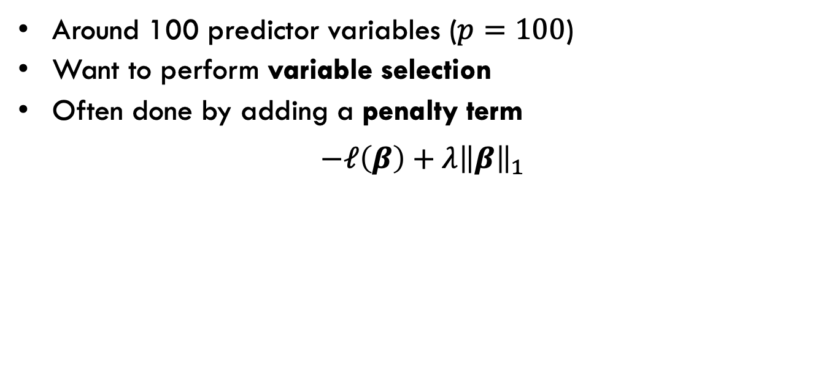
Variable selection
Around 100 predictor variables ($p=100$)
Want to perform variable selection
Often done by adding a penalty term
$$−ℓ\left(β\right)+{λ\left\|β\right\|}_{1}$$
Notes:
The main idea of our paper is incorporating variable selection
Explain how it is done in the LASSO case

Slide 23
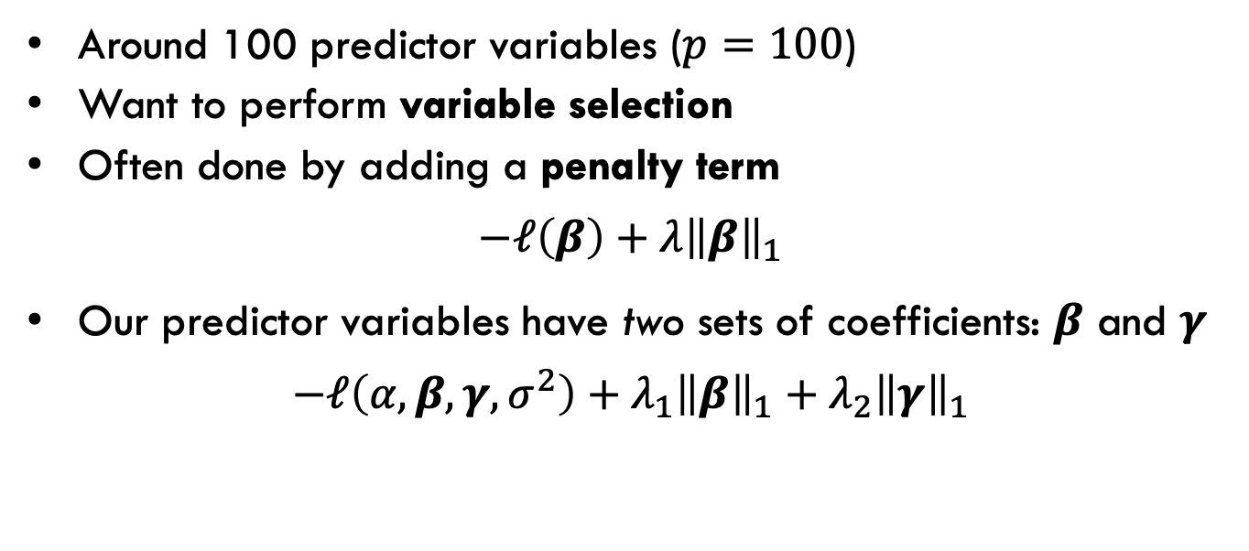
Variable selection
Around 100 predictor variables ($p=100$)
Want to perform variable selection
Often done by adding a penalty term
$$−ℓ\left(β\right)+{λ\left\|β\right\|}_{1}$$
Our predictor variables have two sets of coefficients: $β$ and $γ$
$$−ℓ\left(α,β,γ,σ^{2}\right)+{λ_{1}\left\|β\right\|}_{1}+{λ_{2}\left\|γ\right\|}_{1}$$
Notes:
The main idea of our paper is incorporating variable selection
Explain how it is done in the LASSO case

Slide 24
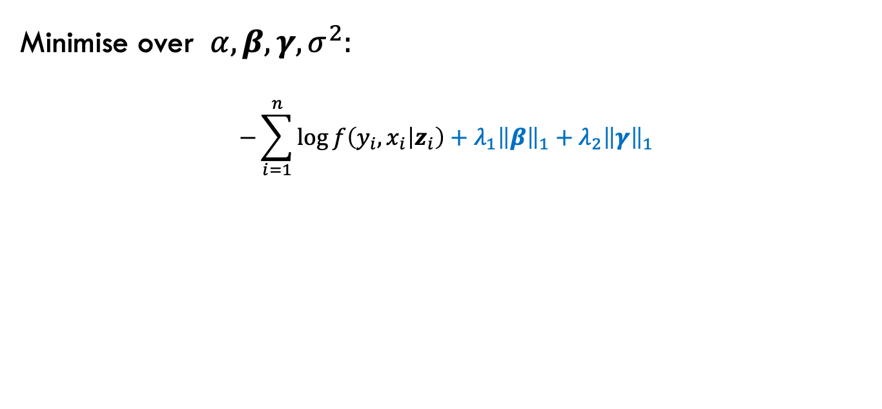

Complete data loss function
Minimise over $α,β,γ,σ^{2}:$
$$−\sum_{i=1}^{n}{\log{f\left(y_{i},x_{i} | z_{i}\right)}}+{λ_{1}\left\|β\right\|}_{1}+{λ_{2}\left\|γ\right\|}_{1}$$
Depends on $α,β,γ,σ^{2}$
Penalties
Notes:
Overview of model fitting process
Loss function consists of negative LL + penalties
LL broken up into complete and censored observations, denoted by delta_i = 1 or 0
Expectation is over X, given X > c (c is censored observation)
log(joint density) contains beta, gamma, sigma^2, so cannot compute expectation without knowing these
Require EM algorithm
Transition from non-censored case to censored case (no delta, no gamma, y|x,z instead of y,x|z)

Slide 25

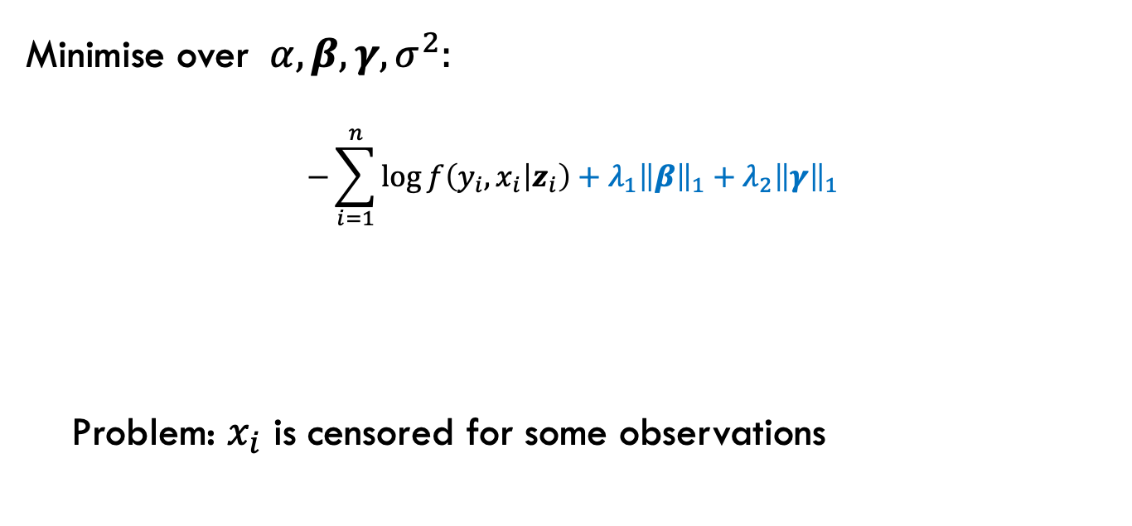
Complete data loss function
Minimise over $α,β,γ,σ^{2}:$
$$−\sum_{i=1}^{n}{\log{f\left(y_{i},x_{i} | z_{i}\right)}}+{λ_{1}\left\|β\right\|}_{1}+{λ_{2}\left\|γ\right\|}_{1}$$
Problem: $x_{i}$ is censored for some observations
Depends on $α,β,γ,σ^{2}$
Penalties
Notes:
Overview of model fitting process
Loss function consists of negative LL + penalties
LL broken up into complete and censored observations, denoted by delta_i = 1 or 0
Expectation is over X, given X > c (c is censored observation)
log(joint density) contains beta, gamma, sigma^2, so cannot compute expectation without knowing these
Require EM algorithm
Transition from non-censored case to censored case (no delta, no gamma, y|x,z instead of y,x|z)

Slide 26
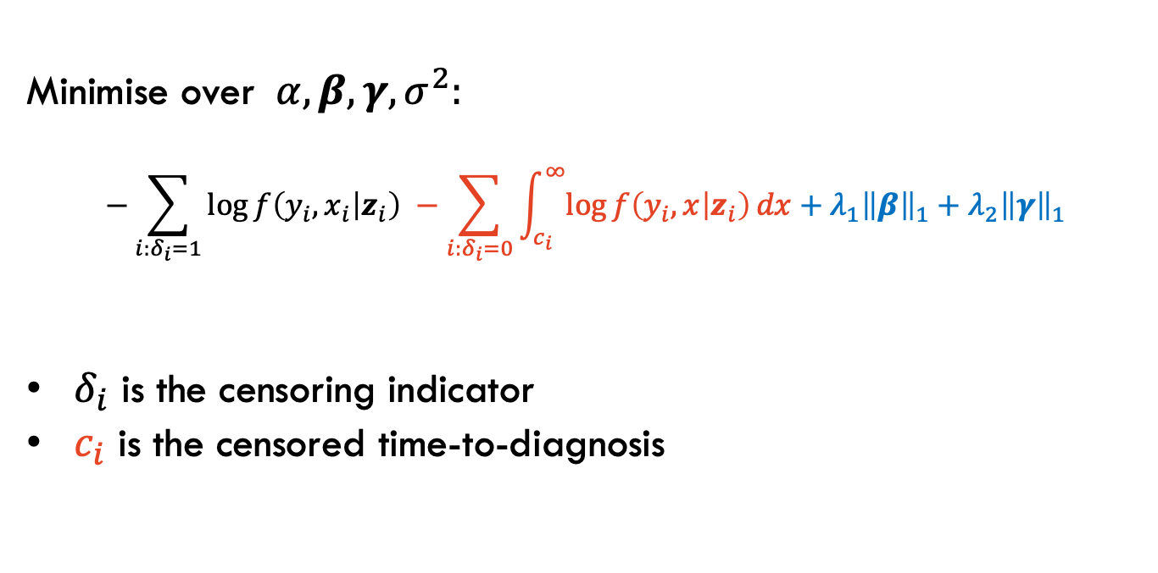
Observed data loss function
Minimise over $α,β,γ,σ^{2}:$
$$−\sum_{i:δ_{i}=1}{\log{f\left(y_{i},x_{i} | z_{i}\right)}} −\sum_{i:δ_{i}=0}{\int_{c_{i}}^{∞}{\log{f\left(y_{i},x | z_{i}\right)}dx}}+{λ_{1}\left\|β\right\|}_{1}+{λ_{2}\left\|γ\right\|}_{1}$$
$δ_{i}$ is the censoring indicator
$c_{i}$ is the censored time-to-diagnosis
Notes:
Overview of model fitting process
Loss function consists of negative LL + penalties
LL broken up into complete and censored observations, denoted by delta_i = 1 or 0
Expectation is over X, given X > c (c is censored observation)
log(joint density) contains beta, gamma, sigma^2, so cannot compute expectation without knowing these
Require EM algorithm
Transition from non-censored case to censored case (no delta, no gamma, y|x,z instead of y,x|z)

Slide 27
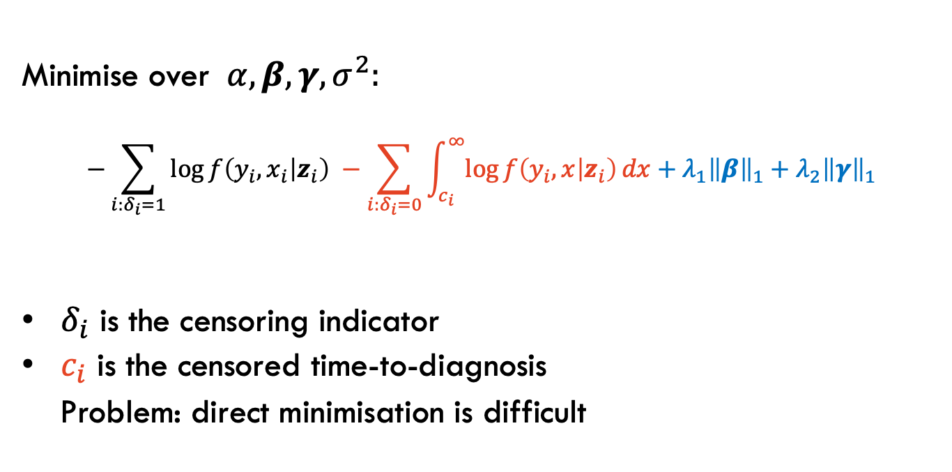
Observed data loss function
Minimise over $α,β,γ,σ^{2}:$
$$−\sum_{i:δ_{i}=1}{\log{f\left(y_{i},x_{i} | z_{i}\right)}} −\sum_{i:δ_{i}=0}{\int_{c_{i}}^{∞}{\log{f\left(y_{i},x | z_{i}\right)}dx}}+{λ_{1}\left\|β\right\|}_{1}+{λ_{2}\left\|γ\right\|}_{1}$$
$δ_{i}$ is the censoring indicator
$c_{i}$ is the censored time-to-diagnosis
Problem: direct minimisation is difficult
Notes:
Overview of model fitting process
Loss function consists of negative LL + penalties
LL broken up into complete and censored observations, denoted by delta_i = 1 or 0
Expectation is over X, given X > c (c is censored observation)
log(joint density) contains beta, gamma, sigma^2, so cannot compute expectation without knowing these
Require EM algorithm
Transition from non-censored case to censored case (no delta, no gamma, y|x,z instead of y,x|z)

Slide 28
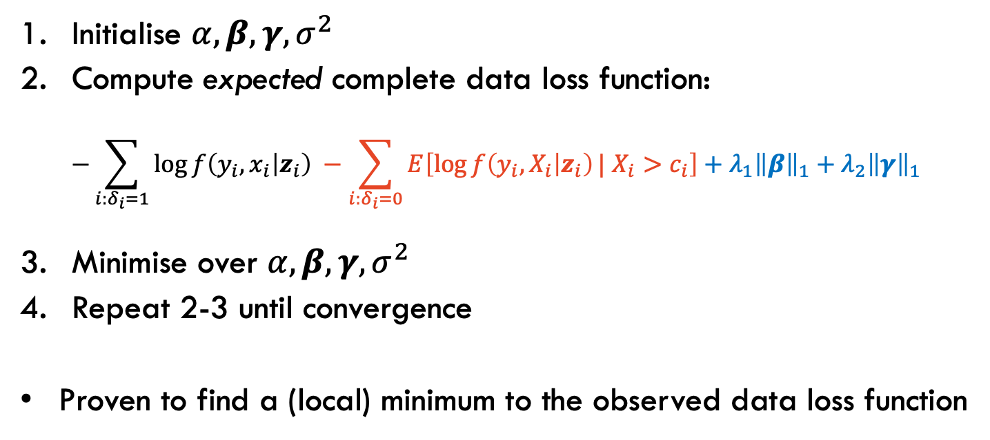
Expectation-Minimisation (EM) algorithm
Initialise $α,β,γ,σ^{2}$
Compute expected complete data loss function:
$$−\sum_{i:δ_{i}=1}{\log{f\left(y_{i},x_{i} | z_{i}\right)}} −\sum_{i:δ_{i}=0}{E\left[\log{f\left(y_{i},X_{i} | z_{i}\right)}| X_{i}>c_{i}\right]}+{λ_{1}\left\|β\right\|}_{1}+{λ_{2}\left\|γ\right\|}_{1}$$
Minimise over $α,β,γ,σ^{2}$
Repeat 2-3 until convergence
Proven to find a (local) minimum to the observed data loss function

Slide 29
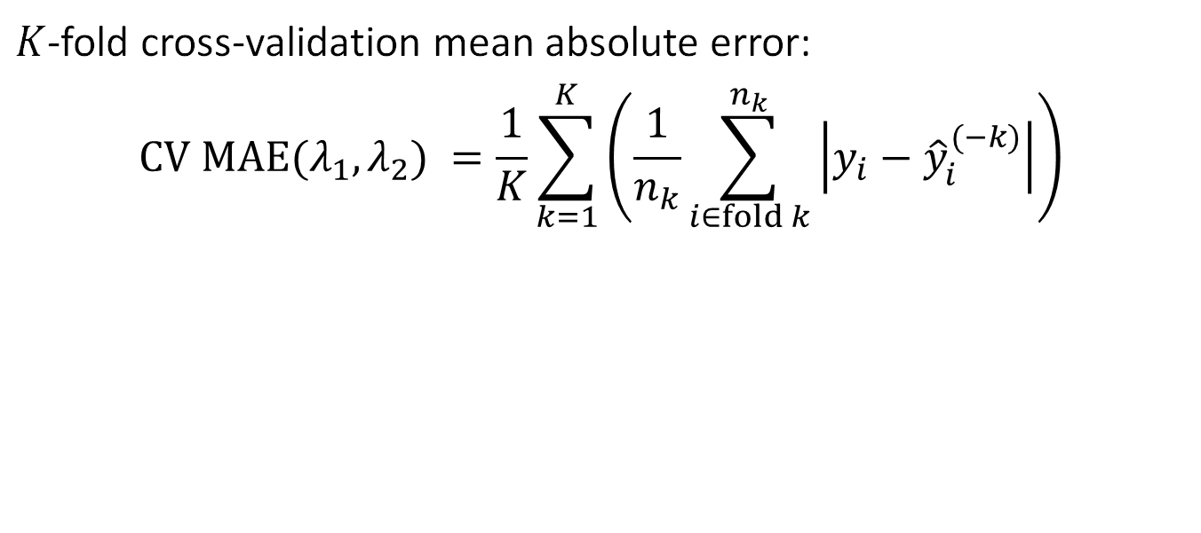
Tuning parameter selection
$K$-fold cross-validation mean absolute error:
$${CV MAE(λ_{1},λ_{2})}_{ }=\frac{1}{K}\sum_{k=1}^{K}{\left(\frac{1}{n_{k}}\sum_{i∈fold k}^{n_{k}}{\left|y_{i}−{\hat{y}}_{i}^{(−k)}\right|}\right)}$$
Notes:
There are two tuning parameters, so need to choose best pair from a grid of (lambda_1, lambda_2) values.
Propose to estimate out-of-sample performance via CV MAE
Outer sum is simply over the K folds
Inner sum is computing MAE when the kth fold is the test fold
yhat is model estimated using all folds except the kth fold
yhat is computed differently depending on if the observation is complete or censored
-k on the parameters is from fitting on all folds except the kth fold

Slide 30
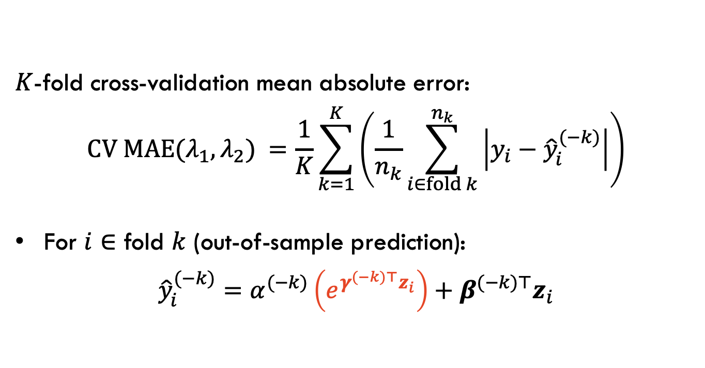
Tuning parameter selection
$K$-fold cross-validation mean absolute error:
$${CV MAE(λ_{1},λ_{2})}_{ }=\frac{1}{K}\sum_{k=1}^{K}{\left(\frac{1}{n_{k}}\sum_{i∈fold k}^{n_{k}}{\left|y_{i}−{\hat{y}}_{i}^{(−k)}\right|}\right)}$$
For $i∈$ fold $k$ (out-of-sample prediction):
$${\hat{y}}_{i}^{(−k)}=α^{(−k)}\left(e^{γ^{(−k)⊤}z_{i}}\right)+β^{(−k)⊤}z_{i}$$
Notes:
There are two tuning parameters, so need to choose best pair from a grid of (lambda_1, lambda_2) values.
Propose to estimate out-of-sample performance via CV MAE
Outer sum is simply over the K folds
Inner sum is computing MAE when the kth fold is the test fold
yhat is model estimated using all folds except the kth fold
yhat is computed differently depending on if the observation is complete or censored
-k on the parameters is from fitting on all folds except the kth fold

Slide 31
Tuning parameter selection
censored
complete
censored
complete
complete
complete
censored
censored
censored
censored
censored
censored
3
censored
censored
complete
6
complete
censored
censored

Slide 32
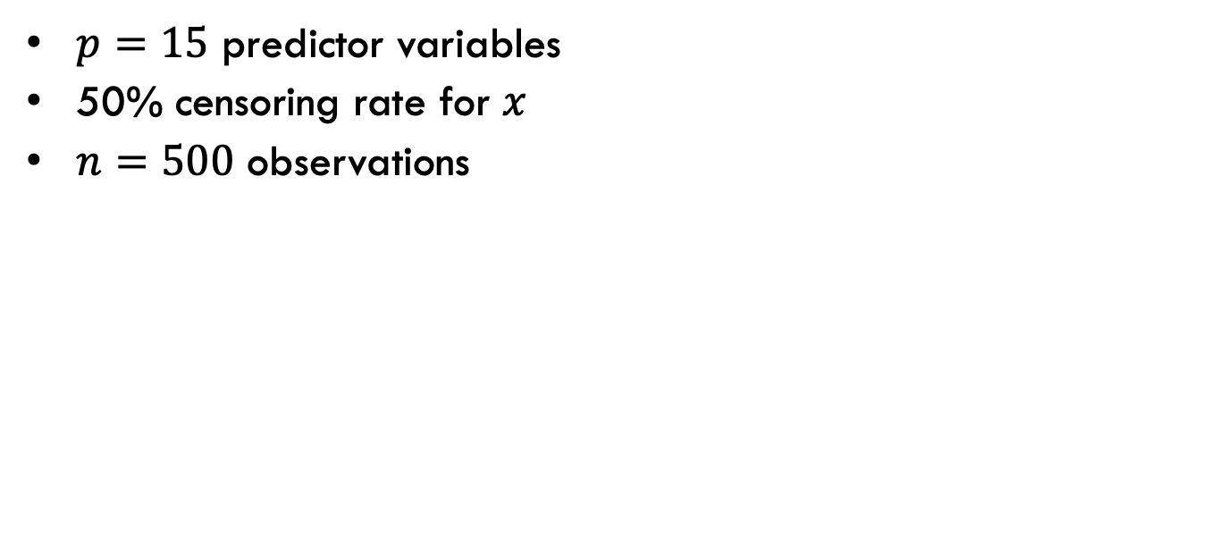
Simulated example
$p=15$ predictor variables
50% censoring rate for $x$
$n=500$ observations

Slide 33
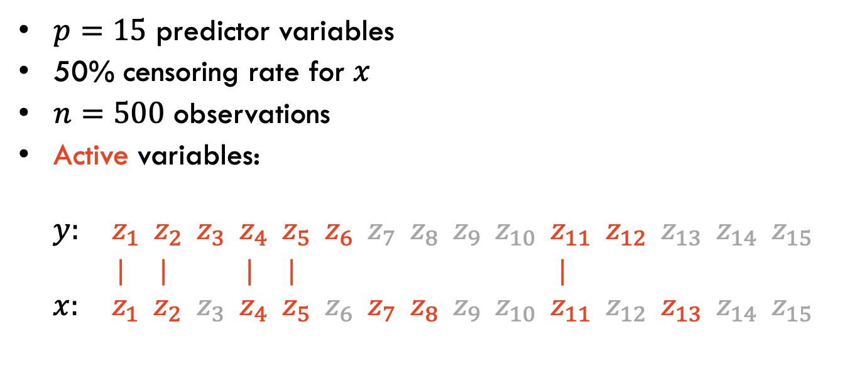
Simulated example
$p=15$ predictor variables
50% censoring rate for $x$
$n=500$ observations
Active variables:
$$y: z_{1} z_{2} z_{3} z_{4} z_{5} z_{6} z_{7} z_{8} z_{9} z_{10} z_{11} z_{12} { z}_{13} z_{14} z_{15}$$
| | | | |
$$x: z_{1} z_{2} z_{3} z_{4} z_{5} z_{6} z_{7} z_{8} z_{9} z_{10} z_{11} z_{12} { z}_{13} z_{14} z_{15}$$

Slide 34
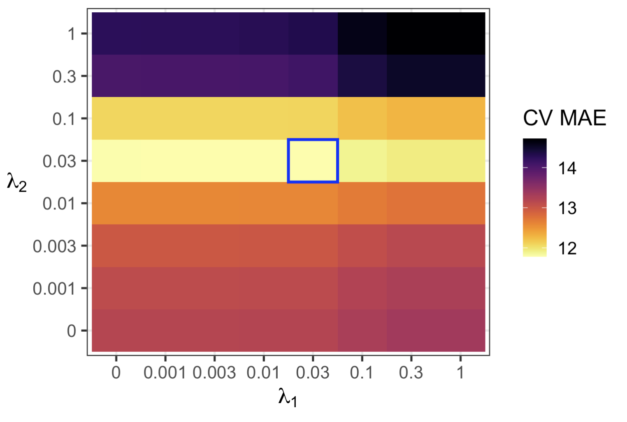
Simulated example

Slide 35
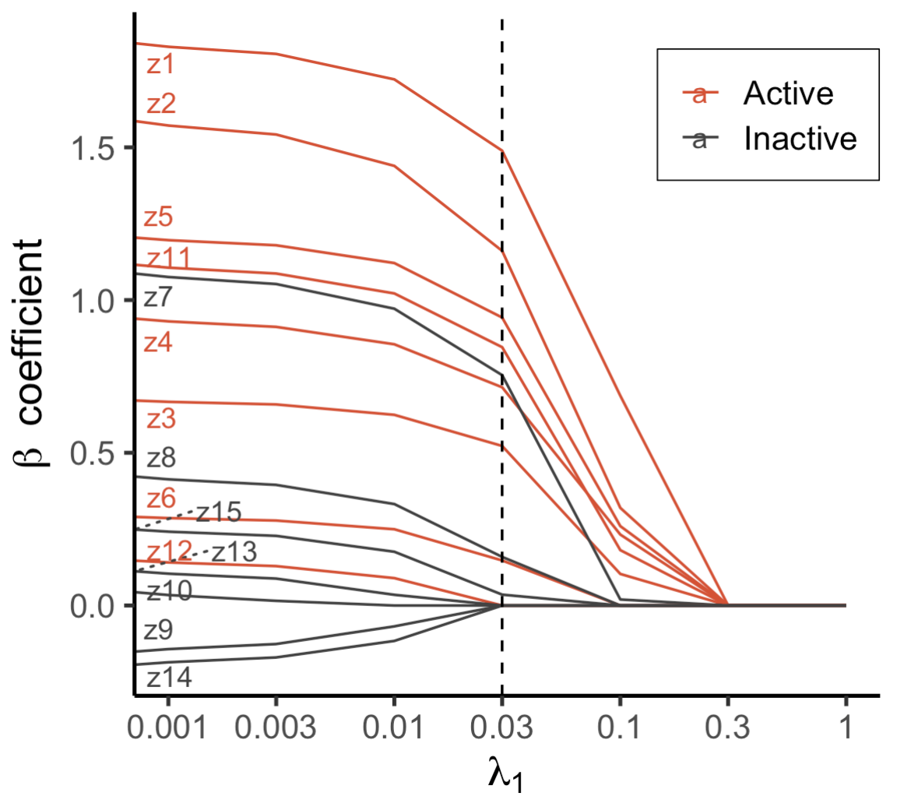
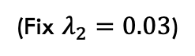
Simulated example
Active variables correct: 7/8
(Fix $λ_{2}=0.03$)
Notes:
Point out that a slightly higher lambda_2 such as 0.1 would not overselect as much

Slide 36
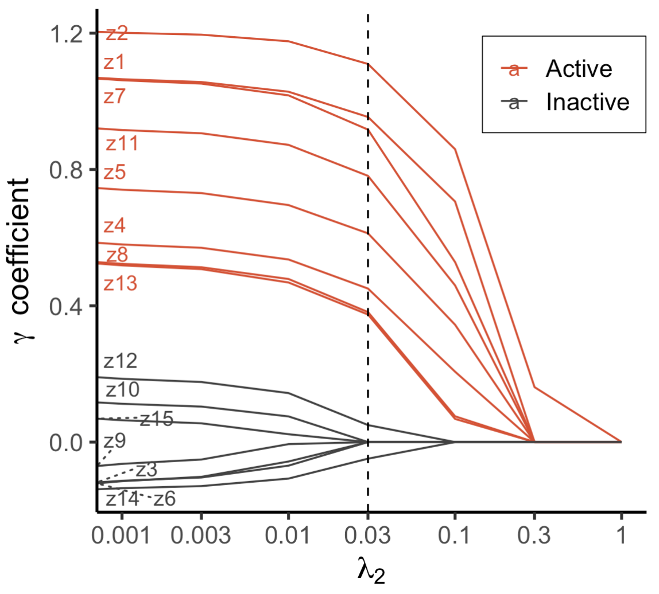
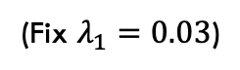
Simulated example
Active variables correct: 7/8
Active variables correct: 8/8
(Fix $λ_{2}=0.03$)
(Fix $λ_{1}=0.03$)
Notes:
Point out that a slightly higher lambda_2 such as 0.1 would not overselect as much

Slide 37


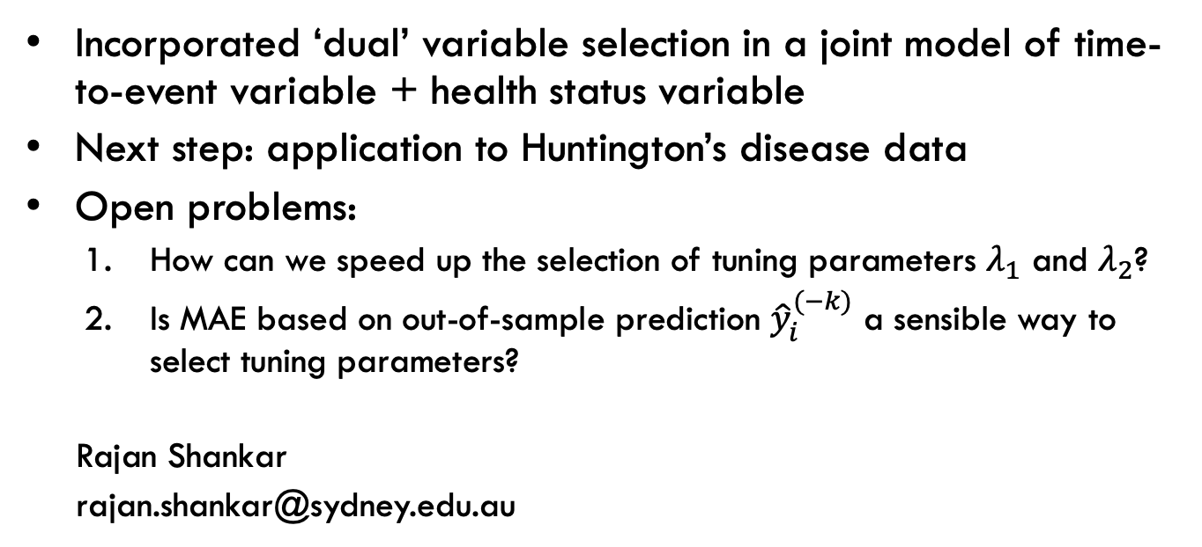
Summary
Incorporated ‘dual’ variable selection in a joint model of time-to-event variable + health status variable
Next step: application to Huntington’s disease data
Open problems:
How can we speed up the selection of tuning parameters $λ_{1}$ and $λ_{2}$?
Is MAE based on out-of-sample prediction ${\hat{y}}_{i}^{(−k)}$ a sensible way to select tuning parameters?
Rajan Shankar
rajan.shankar@sydney.edu.au

Slide 38
Right-censored predictor
Age:
40
45
47
Entry
Diagnosis
Exit
Notes:
Better viz of how right-censoring works
Assume two patients, one uncensored (also called ‘complete’) and one censored

Slide 39
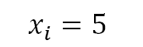
Right-censored predictor
$$x_{i}=5$$
Age:
40
45
47
Entry
Diagnosis
Exit
Notes:
Better viz of how right-censoring works
Assume two patients, one uncensored (also called ‘complete’) and one censored

Slide 40
Right-censored predictor
$$x_{i}=5$$
Age:
40
45
47
Entry
Diagnosis
Exit
Age:
32
39
?
Entry
Exit
Diagnosis
Notes:
Better viz of how right-censoring works
Assume two patients, one uncensored (also called ‘complete’) and one censored

Slide 41
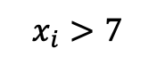
Right-censored predictor
$$x_{i}=5$$
Age:
40
45
47
Entry
Diagnosis
Exit
$$x_{i}>7$$
Age:
32
39
?
Entry
Exit
Diagnosis
Notes:
Better viz of how right-censoring works
Assume two patients, one uncensored (also called ‘complete’) and one censored

Slide 42
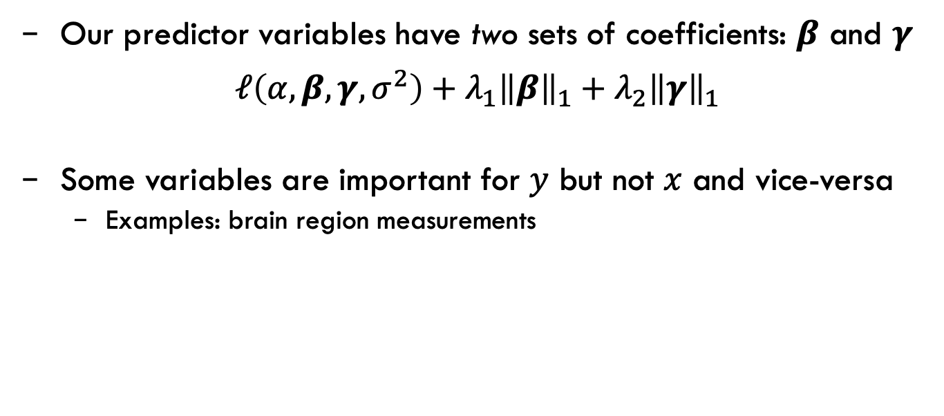
Variable selection
Our predictor variables have two sets of coefficients: $β$ and $γ$
$$ℓ\left(α,β,γ,σ^{2}\right)+{λ_{1}\left\|β\right\|}_{1}+{λ_{2}\left\|γ\right\|}_{1}$$
Some variables are important for $y$ but not $x$ and vice-versa
Examples: brain region measurements
Notes:
Our difficulty is that predictors show up in two places
Two tuning parameters lambda_1 and lambda_2
Examples of how the active set might differ between the two places

Slide 43
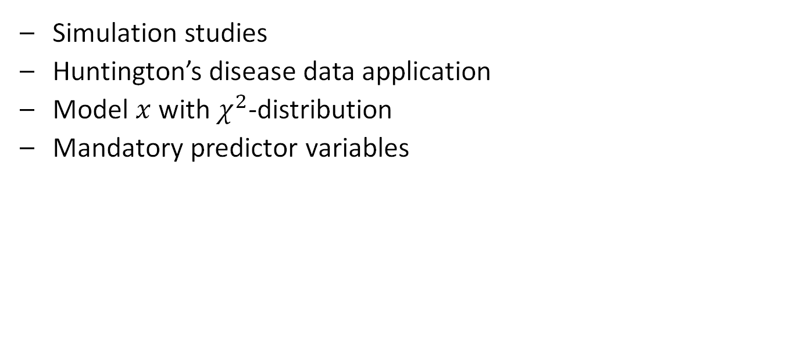
Current research
Simulation studies
Huntington’s disease data application
Model $x$ with $χ^{2}$-distribution
Mandatory predictor variables
Notes:
Working to expand on how we model x
- Better matches the data (chi^2)

Slide 44
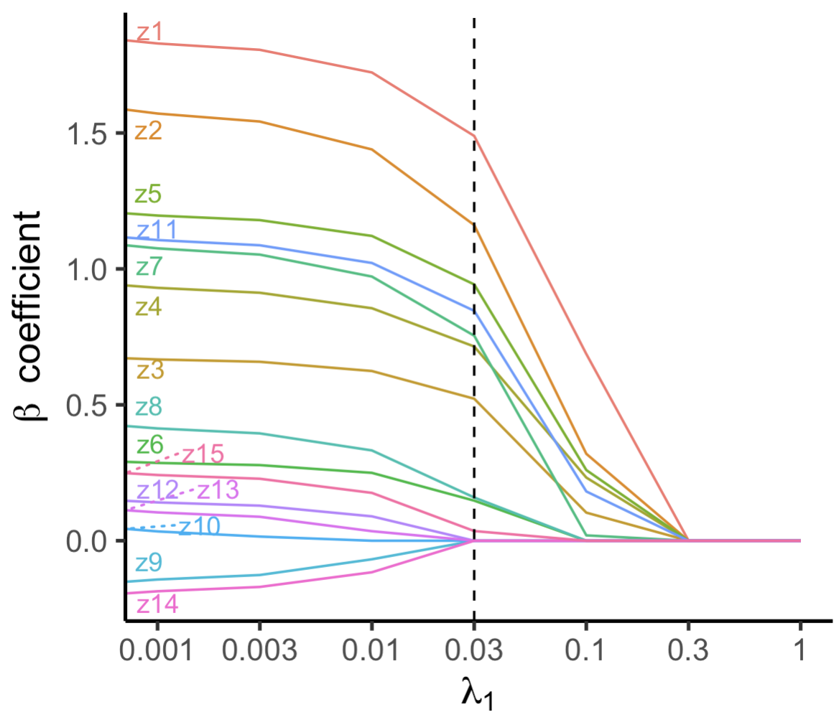
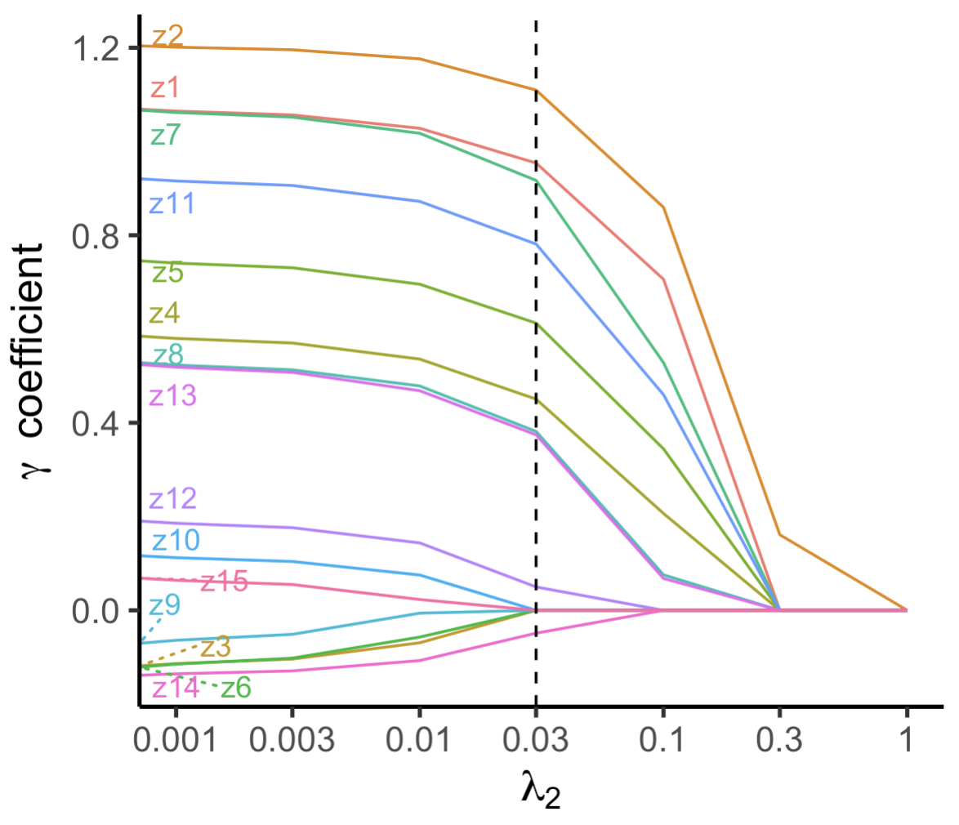
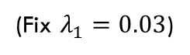
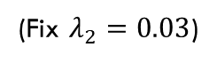
Simulated example
Active variables correct: 7/8
Active variables correct: 8/8
(Fix $λ_{2}=0.03$)
(Fix $λ_{1}=0.03$)
Notes:
Have 0.03 as well
Point out that a slightly higher lambda_2 such as 0.1 would not overselect as much

Slide 45
Huntington’s disease
A gene is a section of DNA
Long sequence of letters A, G, C, T
A: Adenine
G: Guanine
C: Cytosine
T: Thymine
Notes:
- Bit of background on what makes up a gene to give a better understanding of how the disease occurs

